Slide 1
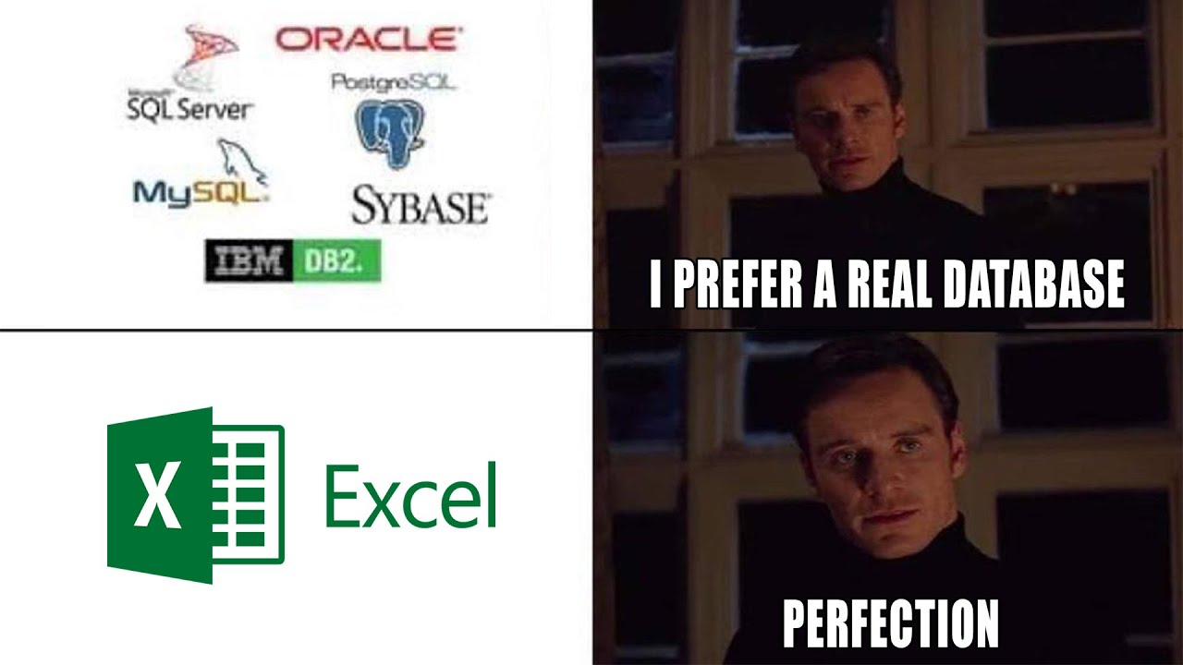

Slide 2
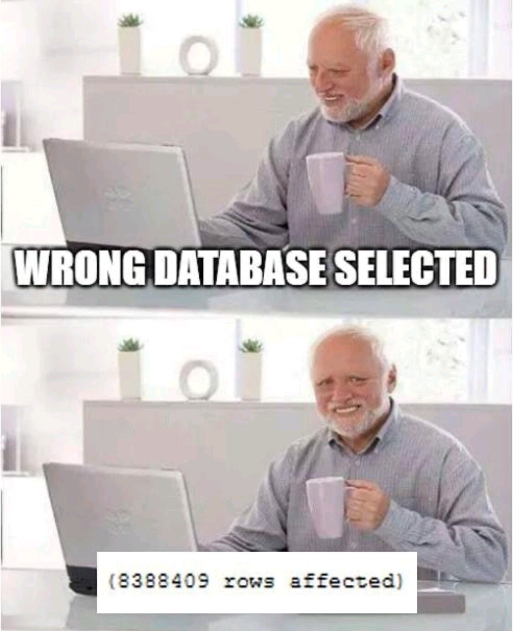

Slide 3

1. Creating Output
2. Variables
3. If Statements
4. Loops
5. Functions

Slide 4







SQL
CLIENT
SERVER
DATABASE

Slide 5
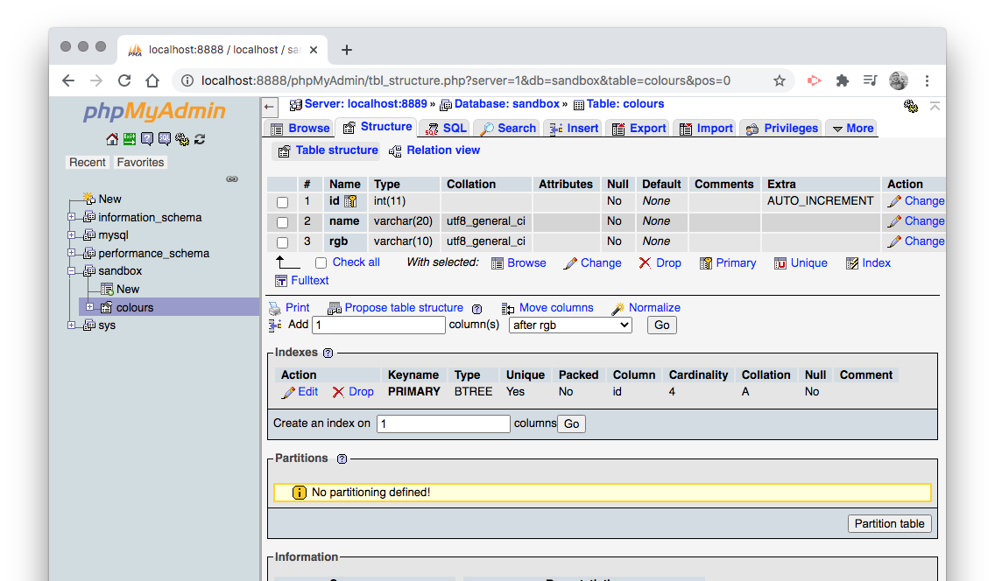

Slide 6
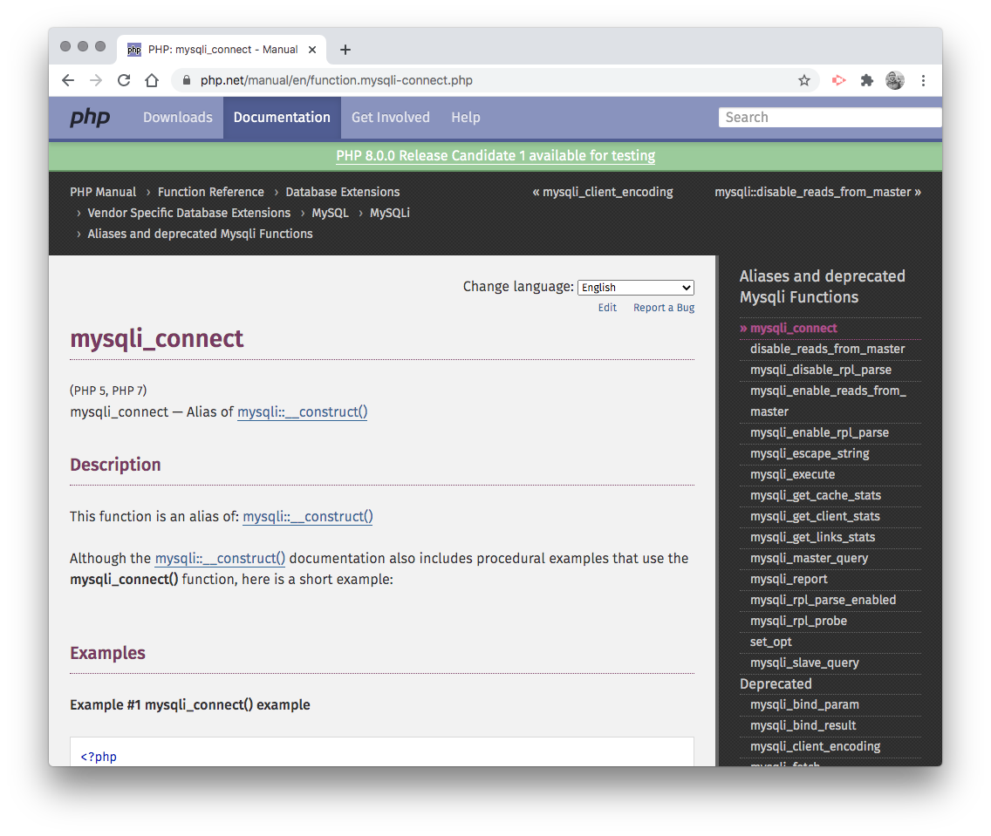
MySQL Connection
To connect PHP to a MySQL database we use the mysqli_connect function:
<?php $connect = mysqli_connect( 'localhost', 'username', 'password', 'database'); ?>

Slide 7

SQL Select Statements
To fetch data from a MySQL database we use an SQL SELECT statement:
SELECT column_name(s) FROM table_name WHERE condition(s) ORDER BY column_name(s)

Slide 8
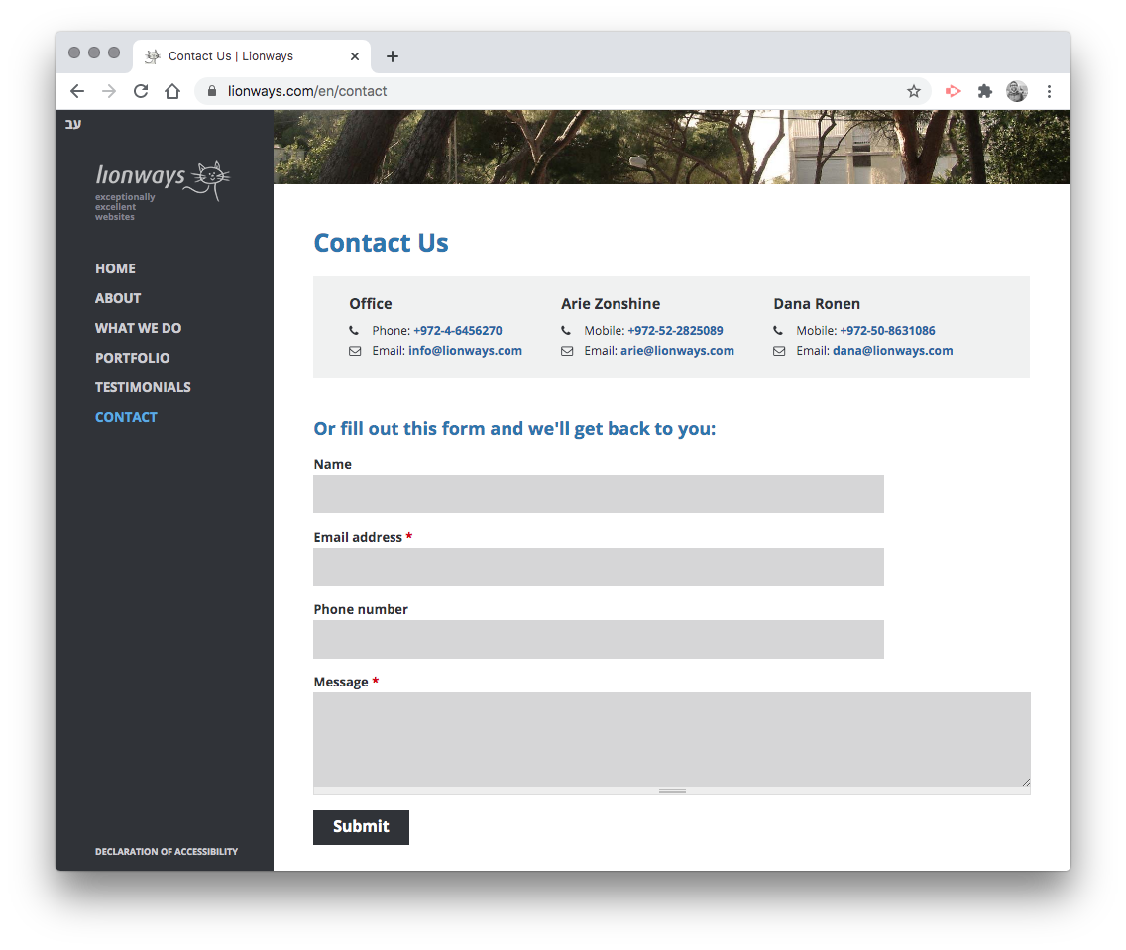
SQL Insert Statements
To insert a new record into a MySQL database we use an SQL INSERT statement:
INSERT INTO table (column_name(s)) VALUES (value(s))

Slide 9
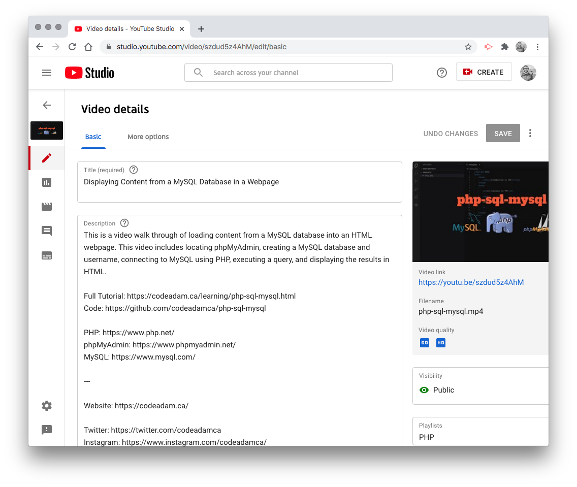
SQL Update Statements
To update data in a MySQL database we use an SQL UPDATE statement:
UPDATE table SET column_name(s) = (value(s)) WHERE condition(s)

Slide 10
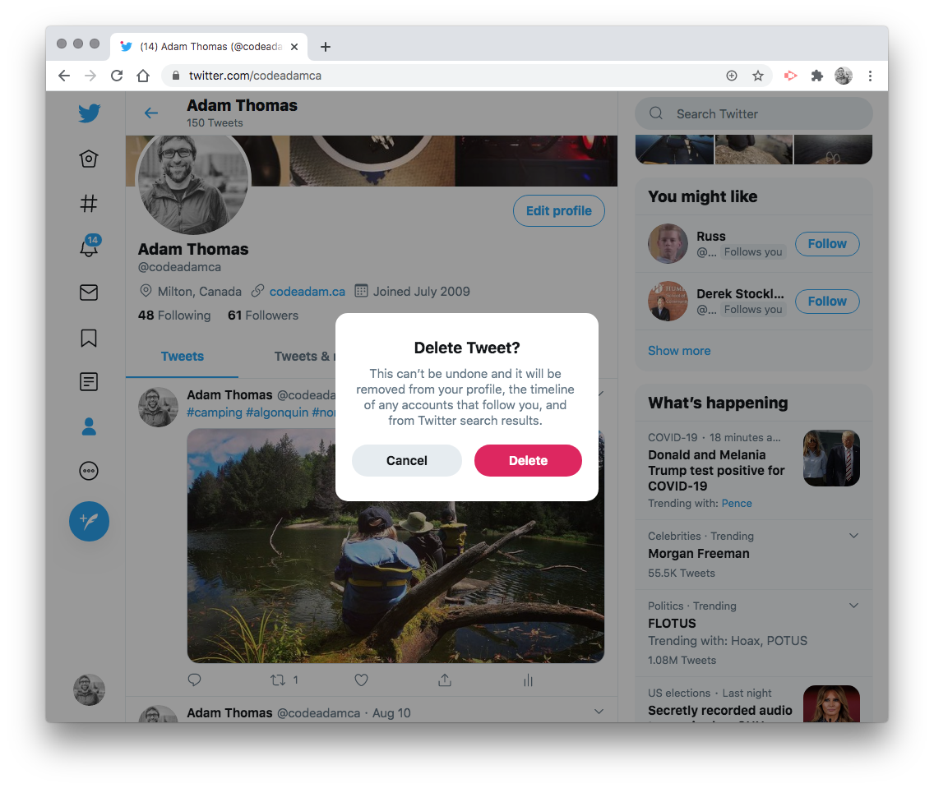
SQL Delete Statements
To update data in a MySQL database we use an SQL UPDATE statement:
DELETE FROM table WHERE condition(s)

Slide 11
Goals this Week
1. Display MySQL data on a webpage 2. Start working on the first PHP assignment

